Slide 1
Heaps
Doç. Dr. Mert Özkaya
(Initially prepared by Dr. Ilyas Cicekli, then improved by Dr. Selim Aksoy)

Slide 2
Heaps
Definition:A heap is a complete binary tree such that
It is empty, or
Its root contains a search key greater than or equal to the search key in each of its children, and each of its children is also a heap.
Since the root contains the item with the largest search key, heap in this definition is also known as maxheap.
On the other hand, a heap which places the smallest search key in its root is know as minheap.
We will talk about maxheap as heap in the rest of our discussions.

Slide 3
Differences between a Heap and a BST
A heap is NOT a binary search tree.
A BST can be seen as sorted, but a heap is ordered in much weaker sense.
Although it is not sorted, the order of a heap is sufficient for the efficient implementation of priority queue operations.
A BST has different shapes, but a heap is always complete binary tree.
50
50
50
HEAPS
40
40
45
40
45
30
35
33
50
42
50
NOT HEAPS
40
40
45
40
30
35

Slide 4
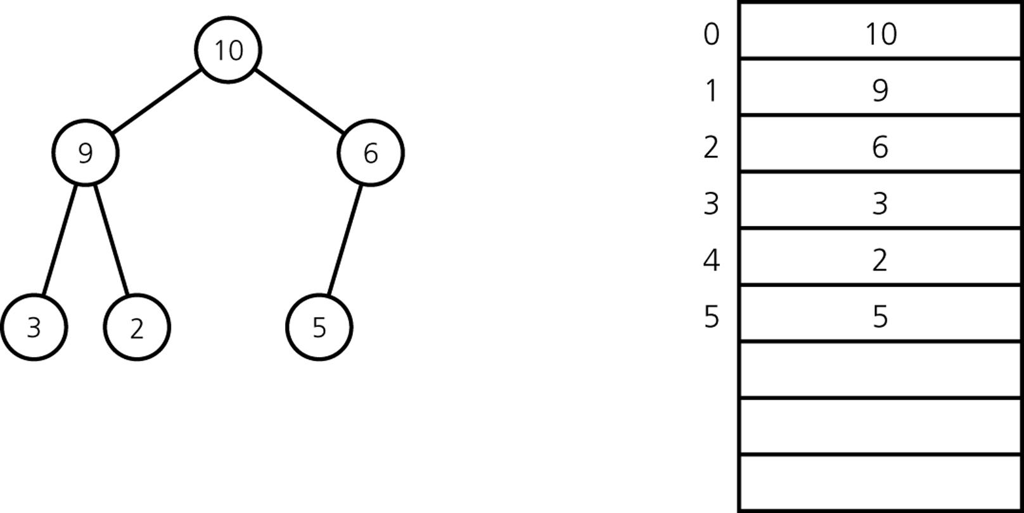
An Array-Based Implementation of a Heap
An array and an integer counter are the data members
for an array-based implementation of a heap.

Slide 5
Major Heap Operations
Two major heap operations are insertion and deletion.
Insertion
Inserts a new item into a heap.
After the insertion, the heap must satisfy the heap properties.
Deletion
Retrieves and deletes the root of the heap.
After the deletion, the heap must satisfy the heap properties.

Slide 6
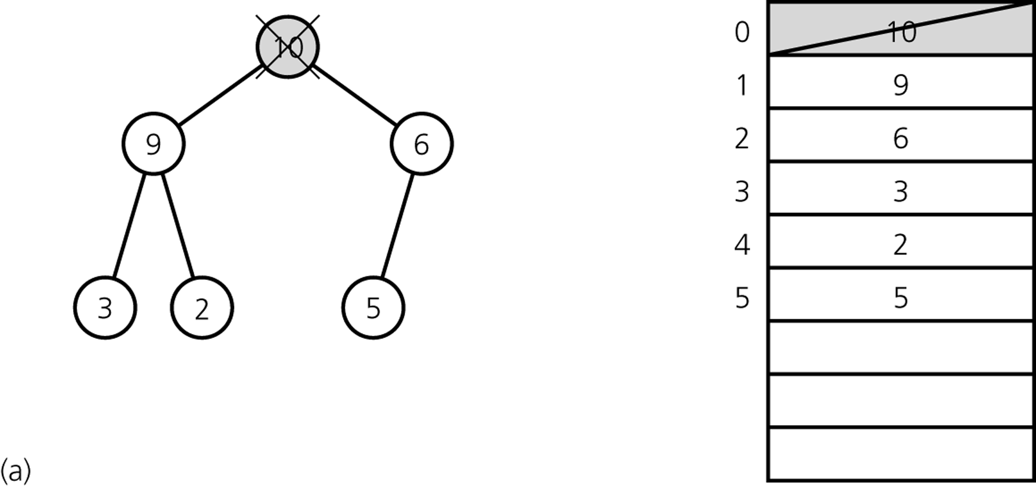
Heap Delete – First Step
The first step of heapDelete is to retrieve and delete the root.
This creates two disjoint heaps.

Slide 7
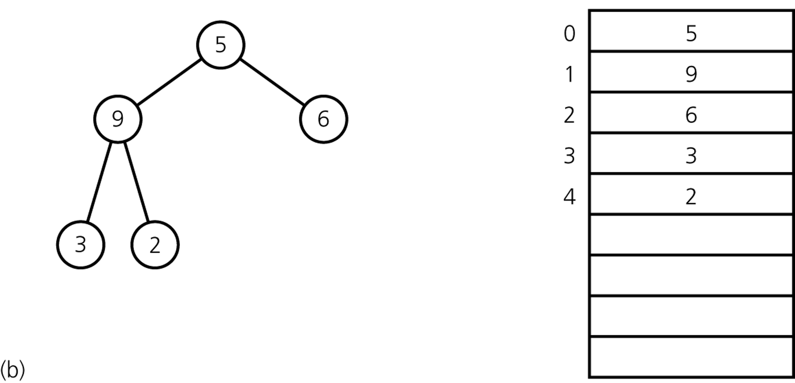
Heap Delete – Second Step
Move the last item into the root.
The resulting structure may not be heap; it is called as semiheap.

Slide 8
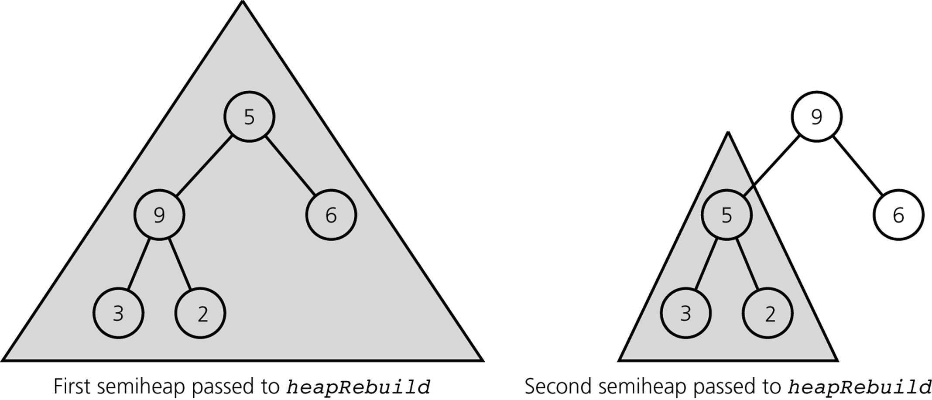
Heap Delete – Last Step
The last step of heapDelete transforms the semiheap into a heap.
Recursive calls to heapRebuild

Slide 9
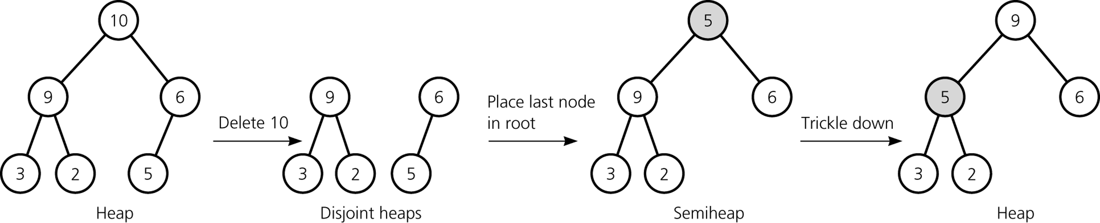
Heap Delete
ANALYSIS
Since the height of a complete binary tree with n nodes is always ⎡ log₂(n+1)⎤
➔ heapDelete is O(log₂n)

Slide 10
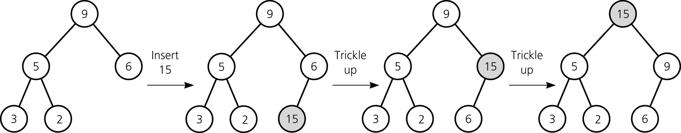
Heap Insert
A new item is inserted at the bottom of the tree,
and it trickles up to its proper place
ANALYSIS
Since the height of a complete binary tree with n nodes is always ⎡ log₂(n+1)⎤
➔ heapInsert is O(log₂n)

Slide 11
Heap Implementation
const int MAX_HEAP = maximum-size-of-heap;
#include "KeyedItem.h"// definition of KeyedItem
typedef KeyedItem HeapItemType;
class Heap {
public:
Heap(); // default constructor
// copy constructor and destructor are supplied by the compiler
bool heapIsEmpty() const;
void heapInsert(const HeapItemType& newItem) throw(HeapException);
void heapDelete(HeapItemType& rootItem) throw(HeapException);
protected:
void heapRebuild(int root); // Converts the semiheap rooted at
// index root into a heap
private:
HeapItemType items[MAX_HEAP]; // array of heap items
int size; // number of heap items
};

Slide 12
Heap Implementation
// Default constructor
Heap::Heap() : size(0) {
}
boolHeap::heapIsEmpty() const {
return (size == 0);
}

Slide 13
Heap Implementation -- heapInsert
void Heap::heapInsert(const HeapItemType& newItem) throw(HeapException) {
if (size >= MAX_HEAP)
throw HeapException("HeapException: Heap full");
// Place the new item at the end of the heap
items[size] = newItem;
// Trickle new item up to its proper position
int place = size;
int parent = (place - 1)/2;
while ( (place > 0) && (items[place].getKey() > items[parent].getKey()) ) {
HeapItemType temp = items[parent];
items[parent] = items[place];
items[place] = temp;
place = parent;
parent = (place - 1)/2;
}
++size;
}

Slide 14
Heap Implementation -- heapDelete
Void Heap::heapDelete(HeapItemType& rootItem) throw(HeapException) {
if (heapIsEmpty())
throw HeapException("HeapException: Heap empty");
else {
rootItem = items[0];
items[0] = items[--size];
heapRebuild(0);
}
}

Slide 15
Heap Implementation -- heapRebuild
voidHeap::heapRebuild(int root) {
int child = 2 * root + 1; // index of root's left child, if any
if ( child < size ) {
// root is not a leaf so that it has a left child
int rightChild = child + 1; // index of a right child, if any
// If root has right child, find larger child
if ( (rightChild < size) &&
(items[rightChild].getKey() >items[child].getKey()) )
child = rightChild; // index of larger child
// If root’s item is smaller than larger child, swap values
if ( items[root].getKey() < items[child].getKey() ) {
HeapItemType temp = items[root];
items[root] = items[child];
items[child] = temp;
// transform the new subtree into a heap
heapRebuild(child);
}
}

Slide 16
The Priority Queue
Priority queue is a variation of the table.
Each data item in a priority queue has a priority value.
Using a priority queue we prioritize a list of tasks:
Job scheduling
Major operations:
Insert an item with a priority value into its proper position in the priority queue.
Deletion is not the same as the deletion in the table. We delete the item with the highest priority.

Slide 17
Priority Queue Operations
create – creates an empty priority queue.
destroy – destroys a priority queue.
isEmpty – determines whether a priority queue is empty or not.
insert – inserts a new item (with a priority value) into a priority queue.
delete – retrieves the item in a priority queue with the highest
priority value, and deletes that item from the priority queue.

Slide 18
Heap Implementation of PriorityQueue
The heap implementation of the priority queue is straightforward
Since the heap operations and the priority queue operations are the same.
When we use the heap,
Insertion and deletion operations of the priority queue will be O(log₂n).

Slide 19
Heap Implementation of PriorityQueue
#include "Heap.h"// ADT heap operations
typedef HeapItemType PQItemType;
class PriorityQueue {
public:
// default constructor, copy constructor, and destructor
// are supplied by the compiler
// priority-queue operations:
bool pqIsEmpty() const;
void pqInsert(const PQItemType& newItem) throw (PQException);
void pqDelete(PQItemType& priorityItem) throw (PQException);
private:
Heap h;
};

Slide 20
Heap Implementation of PriorityQueue
bool PriorityQueue::pqIsEmpty() const {
return h.heapIsEmpty();
}
void PriorityQueue::pqInsert(const PQItemType& newItem) throw (PQException){
try {
h.heapInsert(newItem);
}
catch (HeapException e) {
throw PQueueException("Priority queue is full");
}
}
void PriorityQueue::pqDelete(PQItemType& priorityItem) throw (PQException) {
try {
h.heapDelete(priorityItem);
}
catch (HeapException e) {
throw PQueueException("Priority queue is empty");
}
}

Slide 21
Heapsort
We can make use of a heap to sort an array:
Create a heap from the given initial array with n items.
Swap the root of the heap with the last element in the heap.
Now, we have a semiheap with n-1 items, and a sorted array with one item.
Using heapRebuild convert this semiheap into a heap. Now we will have a heap with n-1 items.
Repeat the steps 2-4 as long as the number of items in the heap is more than 1.

Slide 22
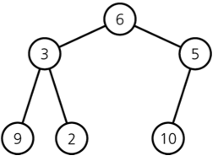

Heapsort -- Building a heap from an array
A heap corresponding to anArray
The initial contents of anArray
for (index = n – 1 ; index >= 0 ; index--) {
// Invariant: the tree rooted at index is a semiheap
heapRebuild(anArray, index, n)
// Assertion: the tree rooted at index is a heap.
}

Slide 23
Heapsort -- Building a heap from an array
A heap corresponding to anArray
The initial contents of anArray
for (index = (n/2) – 1 ; index >= 0 ; index--) { → MORE EFFICIENT
// Invariant: the tree rooted at index is a semiheap
heapRebuild(anArray, index, n)
// Assertion: the tree rooted at index is a heap.
}

Slide 24
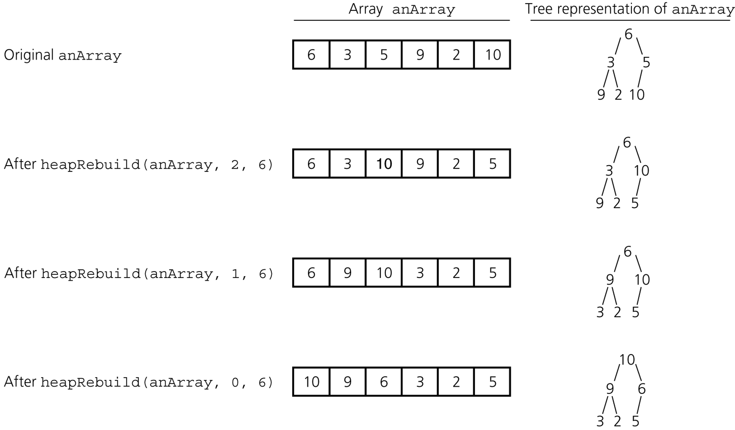
Heapsort -- Building a heap from an array

Slide 25
Heapsort
heapSort(in out anArray:ArrayType, in n:integer) {
// build an initial heap
for (index = (n/2) – 1 ; index >= 0 ; index--)
heapRebuild(anArray, index, n)
for (last = n-1 ; last >0 ; last--) {
// invariant: anArray[0..last] is a heap,
// anArray[last+1..n-1] is sorted and
// contains the largest items of anArray.
swap anArray[0] and anArray[last]
// make the heap region a heap again
heapRebuild(anArray, 0, last)
}
}

Slide 26
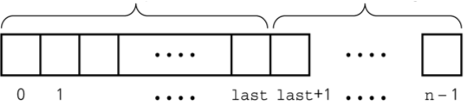
Heapsort
Heapsort partitions an array into two regions.
Each step moves an item from the HeapRegion to SortedRegion.
The invariant of the heapsort algorithm is:
After the kth step,
The SortedRegion contains the k largest value and they are in sorted order.
The items in the HeapRegion form a heap.
HeapRegion
SortedRegion

Slide 27
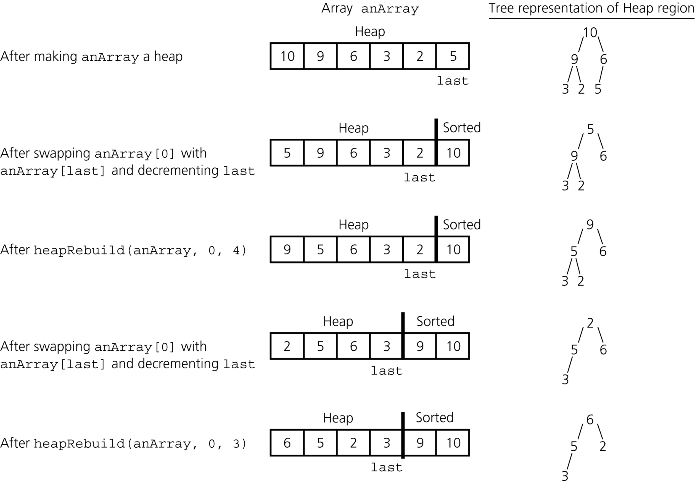
Heapsort -- Trace

Slide 28
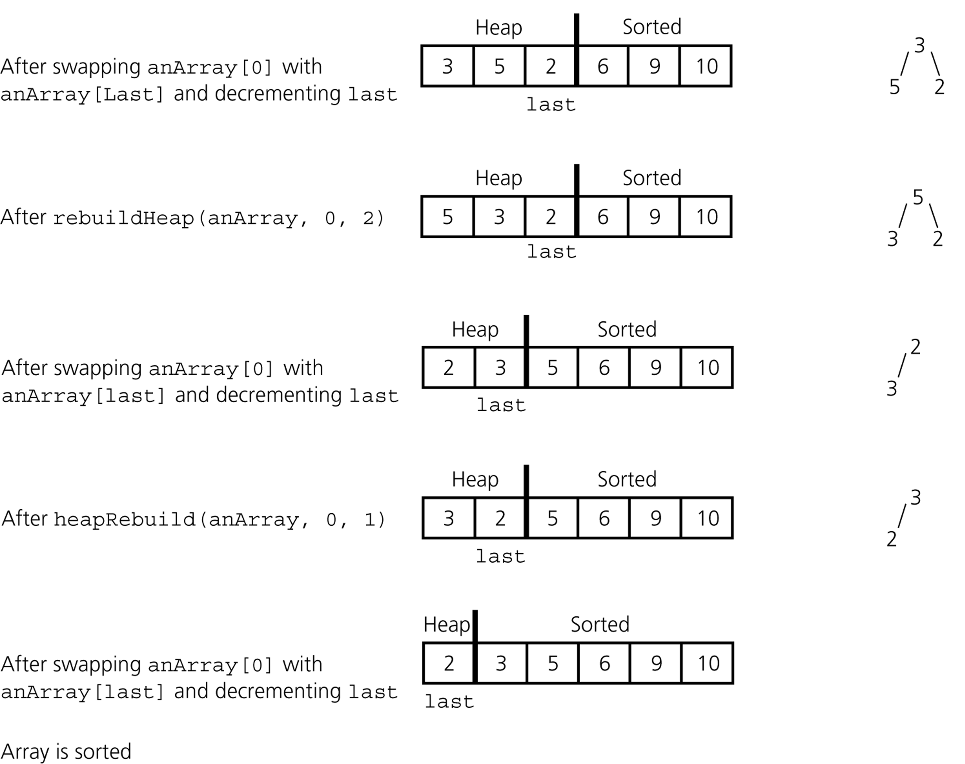
Heapsort -- Trace

Slide 29
Heapsort -- Analysis
Heapsort is
O(n log n) at the average case
O(n log n) at the worst case

